Slide 1



VA Meeting – June 20th 2023
MINTS-AI
Notes:
I’ll just chat briefly about
some of the sensor metrics
What sort of data we might expect to see
If there’s interest, exploring suicide incidence in veterans and environmental conditions and suicide ideation itself

Slide 2
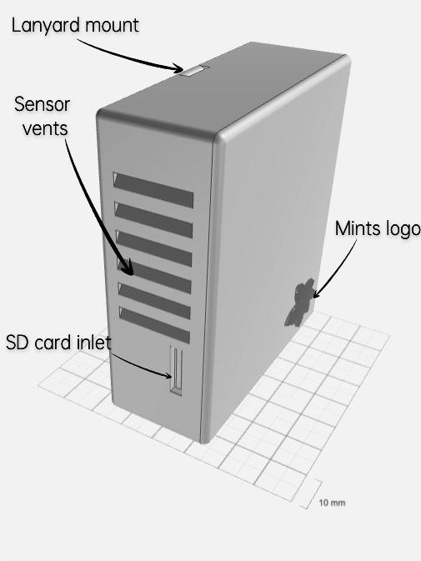
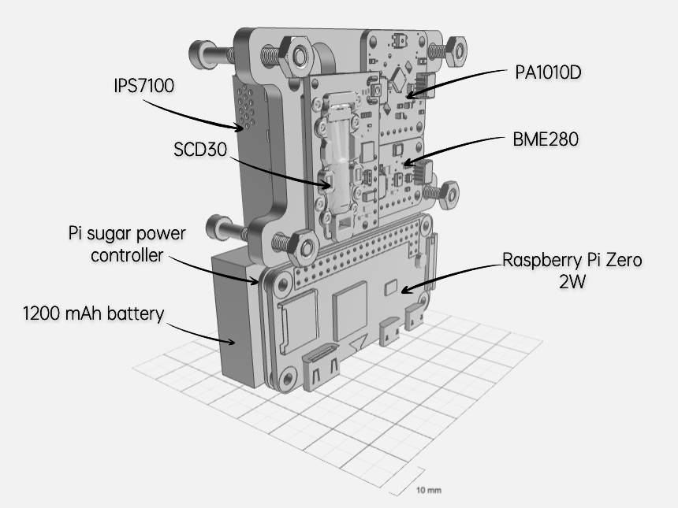
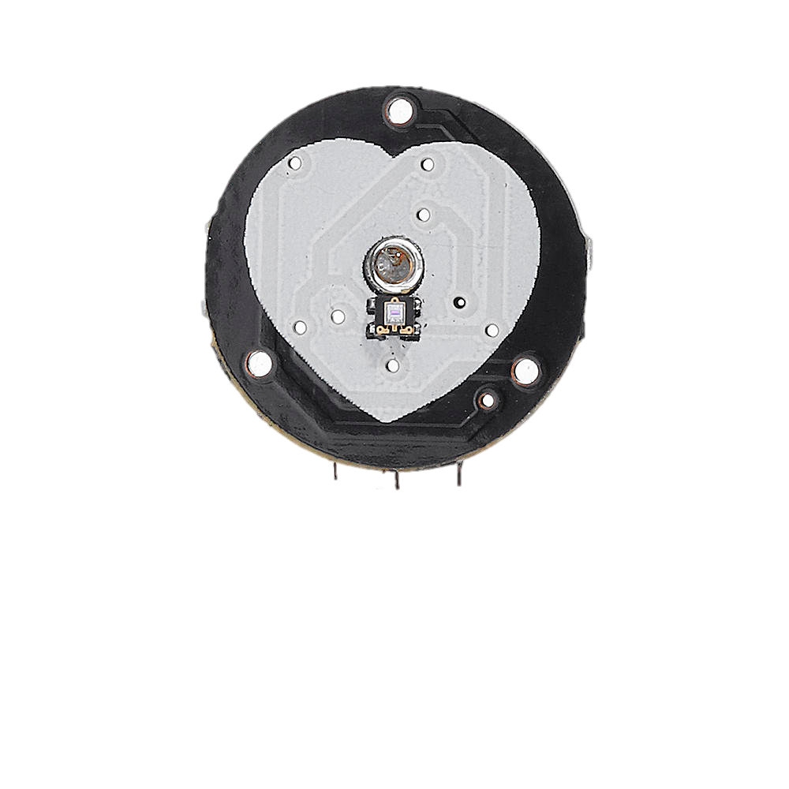
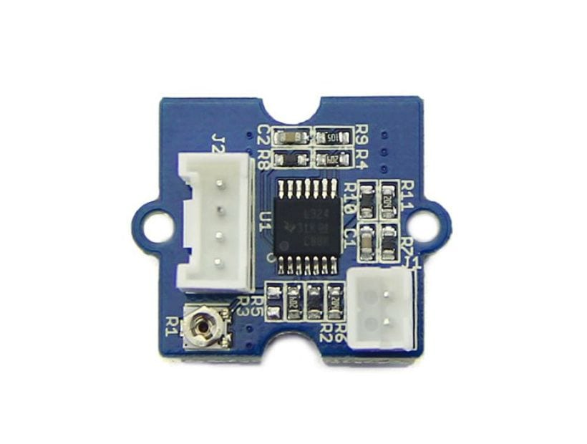
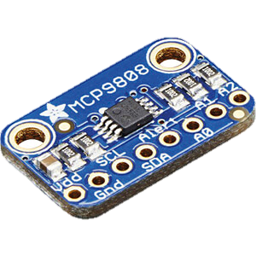
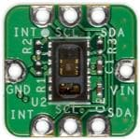
Sensing Suite
Wearable Unit
^{IPS7100}
^{BME680}
^{SCD30}
^{PA101D}
^{MBR001}
Wrist Band Unit
MCP9808
PSA109
700-MAXREFDES117#
LM324

Slide 3

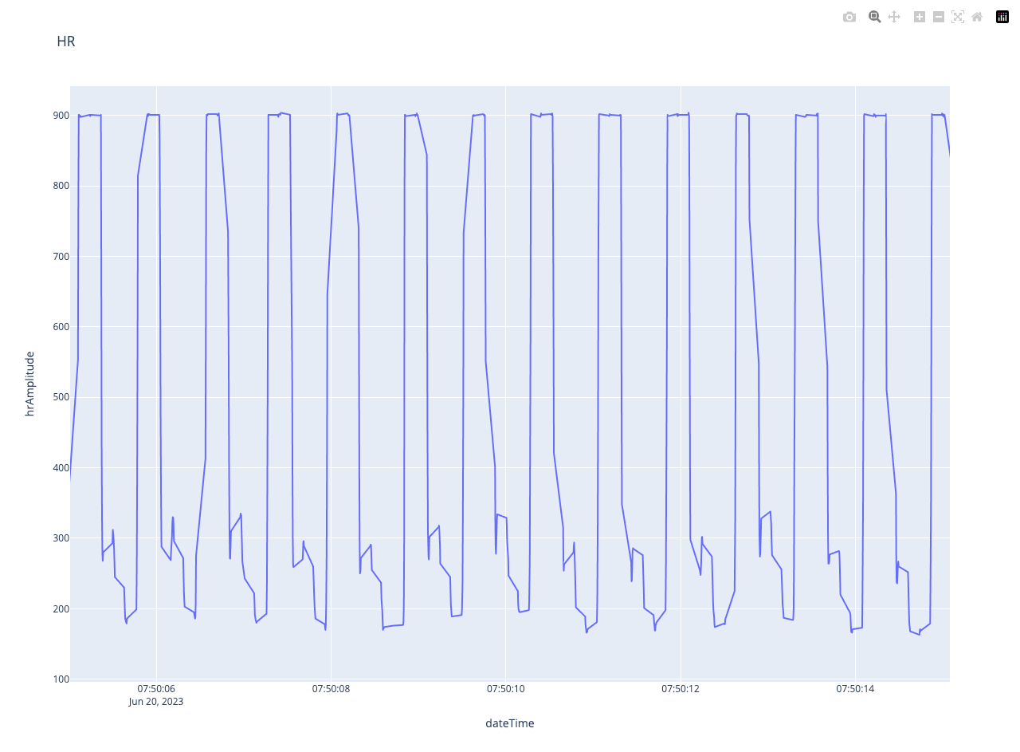

MINTS WRIST BAND

